Slide 1


SAP Cloud Integration
Training
ON THE
SAP BUSINESS TECHNOLOGY PLATFORM
Date: Jan 10th, 2023
Time: 9:00AM IST
Facilitator: Anu
www.anubhavtrainings.com

Slide 2
Agenda
Recap
SAP BTP
Global account
subaccounts
Trial account
Services
User account
CPI url
Session recap
QnA
Integration suit
Messaging
Aplication connectors
SAP Connectors
EIP
API
Difference between Integration suit and CPI

Slide 3
Integration Suit
SAP Integration Suite connects and contextualizes processes and data while enabling new content-rich applications to be assembled faster with less dependence on IT. Pre-built integration packs along with existing investments can be composed to deliver new outcomes with less involvement by integration experts
This service runs in the SAP BTP, Cloud Foundry environment.

Slide 4
Integration SUitE
Features:
Design and operate integration scenarios
Design, develop, and manage APIs
Enable connectivity of applications
Use integration packs
Simplify mapping implementation
Manage integrations with trading partners

Slide 5
Integration Suit
Capabilities
Cloud Integration- Integrate SAP and non-SAP, cloud, and on-premise applications and process messages in real-time scenarios spanning different companies, organizations, or departments within one organization
API Management
Open Connectors
ntegration Advisor
Trading Partner Management
Integration Assessment

Slide 6
What is SAP CI
Support end-to-end process integration through the exchange of messages.
SAP Cloud Integration helps you to connect cloud and on-premise applications with other SAP and non-SAP cloud and on-premise applications. This service has the capabilities to process messages in real-time scenarios spanning different companies, organizations, or departments within one organization.

Slide 7
Features
Implement diverse scenarios
Connect to multiple endpoints
Customize SAP integration scenarios
Develop custom adapters
Access public APIs
Set up secure and reliable communication
Implement various communication modes
Integrate with SAP Process Orchestration

Slide 8
INtegraion Suit and SAP CI

Slide 9
Global Account
A global account is the realization of a contract you or your company has made with SAP. A global account is used to manage subaccounts, members, entitlements and quotas.
There are two types of commercial models for global accounts: consumption-based model and subscription-based model

Slide 10
Adapters
Various adapters (i.e. technical protocols which are used to connect a sender or receiver to the tenant (CPI), are provided by SAP, such as SOAP, OData, Mail, SuccessFactors, HTTPs, Ariba, Facebook, Twitter, ProcessDirect, etc)

Slide 11
Consumption-based commercial model: Your organization receives access to all current and future services that are eligible for this model. You have complete flexibility to turn services on and off and to switch between services as your business requires throughout the duration of your contract. This commercial model is available in two flavors: Cloud Platform Enterprise Agreement (CPEA) and Pay-As-You-Go for SAP BTP.

Slide 12
CPEA
Your organization makes a prepaid investment in cloud credits for the contract duration with an annual commitment to consume SAP BTP services.
This model is suitable for customer who want the flexibility of turning services on and off, and switching between services, without the commitment of being tied to a single service throughout the duration of the contract.

Slide 13
Pay-As-You-Go for SAP BTP
same access to all the services that are available in CPEA, but with a highly flexible zero-commitment model – you pay nothing upfront and there is no minimum usage requirement or annual commitment.
You pay only for the SAP BTP services that you want, when you use them.
billed monthly in arrears
Service charges are non-discountable
his low-risk model is suitable for customers with use cases that are not well defined, and are interested in running a proof-of-concept in a productive environment.
This model provides the flexibility of turning services on and off, and switching between services, as needed throughout the duration of the contract.

Slide 14
Subscription-based commercial model: Your organization subscribes only to the services that you plan to use. You can then use these services at a fixed cost, irrespective of consumption.

Slide 15
Your organization receives a fixed price and period (typically a 1 to 3-year period) for access to your subscribed SAP BTP services.
▪ You are entitled to use only the subscribed services
▪ To access additional services, at an extra cost, you can modify your contract via your sales representative or account executive
▪ You pay at a fixed cost, regardless of consumption of subscribed services
▪ You pay in advance when the contract period starts.
▪ Your organization can renew the subscription at the end of the contract period

Slide 16
Can an existing global account under a consumption-based contract be transformed to the subscription-based model?
You can change your existing contract from the consumption-based commercial model to a subscription license. Keep in mind that not all services that are eligible for the consumption-based model are compatible with the subscription-based model.
recommend that you contact your SAP account executive or sales representative to discuss feasibility and terms of transforming your contract.

Slide 17
Trail Account
A trial account lets you try out SAP BTP for free for 365 days. Access is open to everyone. Trial accounts are intended for personal exploration, and not for production use or team development. They allow restricted use of the platform resources and services.

Slide 19
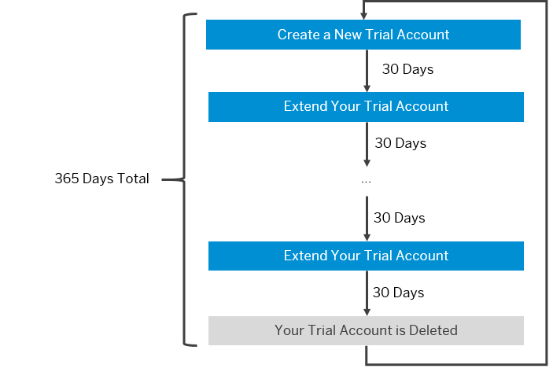
Delete your SAP BTP trial account.

Slide 20
After 365 days, your trial account is automatically deleted. If you want to proactively delete your SAP BTP trial account, you can navigate to the global accounts scope and select the Account Explorer page, then click the Delete Trial Account button.
If you want to continue to use an SAP BTP trial account, you need to register for a new account.
If you want to explore SAP BTP without time limit, create an enterprise account with free tier service plans allowing you to test your scenarios.
Extend your SAP BTP trial account in 30-day intervals.

Slide 21
Subaccounts
Subaccounts let you structure a global account according to your organization’s and project’s requirements with regard to members, authorizations, and entitlements.
A global account can contain one or more subaccounts in which you deploy applications, use services, and manage your subscriptions.

Slide 22
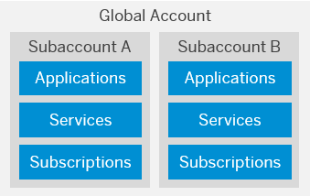

Slide 24
Ariba
Connects SAP Cloud Integration to the Ariba Network. Using this adapter, SAP and non-SAP cloud applications can receive business-specific documents in commerce eXtensible Markup Language (cXML) format from the Ariba network.
The sender adapter allows you to define a schedule for polling data from Ariba.

Slide 26
Data Store
Enables SAP Cloud Integration to consume messages from a data store.

Slide 27
IDOC
Allows SAP Cloud Integration to exchange Intermediate Document (IDoc) messages with a sender system that supports communication via SOAP Web services.
A size limit for the inbound message can be configured for the sender adapter.

Slide 28
JMS
Enables asynchronous messaging by using message queues.
The sender adapter consumes messages from a queue. The messages are processed concurrently.
To prevent situations where the JMS adapter tries again and again to process a failed (large) message, you can store messages (where the processing stopped unexpectedly) in a dead-letter queue after two retries.

Slide 29
Odata
Connects SAP Cloud Integration to systems using the Open Data (OData) protocol in either ATOM or JSON format (only synchronous communication is supported).
The adapter receives incoming requests in either ATOM or JSON format.
Supported operations: Create (POST), Delete (DELETE), Query (GET), Read (GET), Update (PUT)

Slide 30
Open Connector
Connects SAP Cloud Integration to more than 150 non-SAP Cloud applications that are supported by SAP Open Connectors.
Uses APIs to fetch data from specific third-party applications.
Is designed to handle large volumes of incoming data.
Supports messages in both JSON and XML format, for request and response calls.

Slide 31
Process Direct
Connects an integration flow with another integration flow deployed on the same tenant.
An integration flow with a ProcessDirect sender adapter (as consumer) consumes data from another integration flow.
N:1 cardinality of producer and consumer integration flows is supported.

Slide 32
SOAP
Exchanges messages with a sender system that supports Simple Object Access Protocol (SOAP) 1.1 or SOAP 1.2.
The message exchange patterns supported by the sender adapter are one-way messaging or request-reply.
The adapter supports Web services Security (WS-Security).
A size limit for the inbound message can be configured for the sender adapter.
SOAP SOAP 1.x
SOAP SAP RM

Slide 33
HTTPS
Establishes an HTTPS connection between SAP Cloud Integration and a sender system.

Slide 34
HTTP
Establishes an HTTP connection between SAP Cloud Integration and a receiver system.
Receiver adapter:
Supports HTTP 1.1 only (target system must support chunked transfer encoding and may not rely on the existence of the HTTP Content-Length header)
Supports the following methods: DELETE, GET, HEAD, POST, PUT, TRACE
Method can also be determined dynamically by reading a value from a message header or property during runtime.

Slide 35
Thank you

Slide 36
SAP Cloud Integration
Training
ON THE
SAP BUSINESS TECHNOLOGY PLATFORM
Date: Jan 11th, 2023
Time: 8:00AM IST
Facilitator: Anu
www.anubhavtrainings.com

Slide 37
Agenda
Services in SAP BTP
Adapters
SAP CPI overview

Slide 39
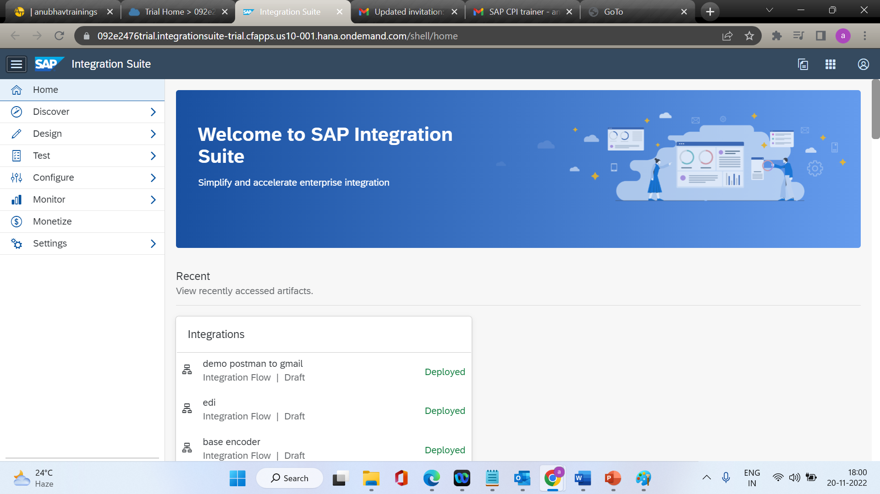

Slide 40
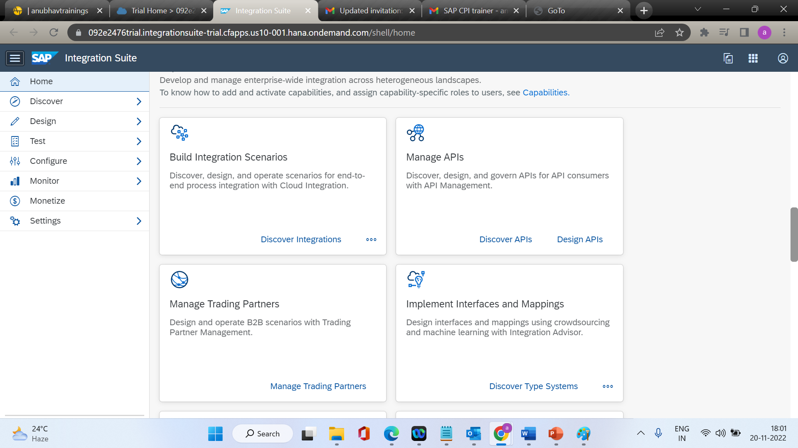

Slide 41
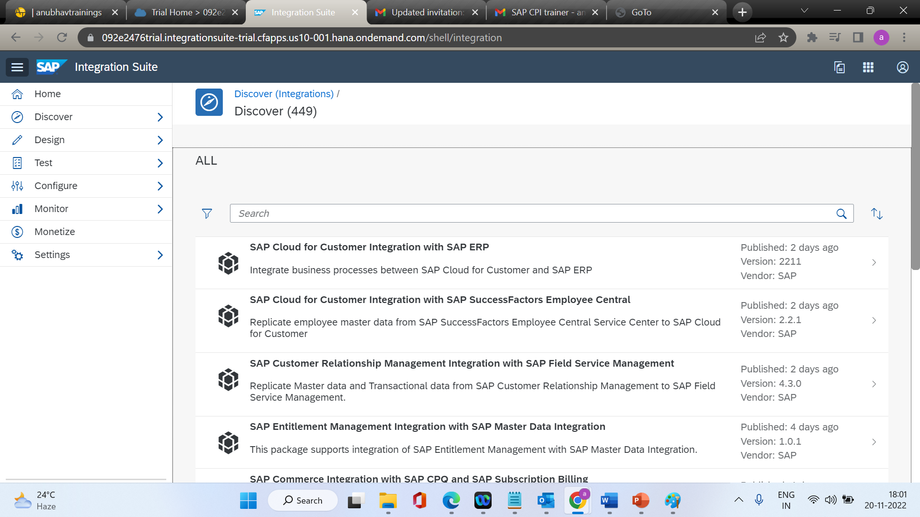

Slide 42
What Is SAP Cloud Integration?
Support end-to-end process integration through the exchange of messages.
SAP Cloud Integration helps you to connect cloud and on-premise applications with other SAP and non-SAP cloud and on-premise applications. This service has the capabilities to process messages in real-time scenarios spanning different companies, organizations, or departments within one organization

Slide 43
Feature Overview
Core runtime for processing, transformation, and routing of messages to be exchanged between the involved customer systemsIt is ensured that data related to different customers connected to Cloud Integration is isolated. This is important, for example, when using Cloud Integration for business-to-business scenarios.
Out-of-the-box connectivity support (for example, IDoc, SFTP, SOAP/HTTPS, SuccessFactors, OData, HTTPS)
Security features such as content encryption and certificate-based communication

Slide 44
Cloud Integration offers full flexibility in how messages can be exchanged between customer systems by the following:
Leveraging preconfigured integration patterns. These integration patterns provide different options for configuring the data flow between participants, for example, by using routing rules.
Using various connectivity options. This covers a set of adapters (or endpoint types) that allow participants to connect with different communication protocols to SAP Cloud Integration.

Slide 45
Cloud Integration Runtime Features
There is a wide range of supported ways how Cloud Integration can process messages and exchanged them with sender and receiver systems (see: Integration Capabilities and Connectivity (Adapters)).
For the delivery of messages received from a sender system Cloud Integration supports quality of service at least once. This means that the platform guarantees to process an inbound message at least once on the tenant. When you use the one of the following adapters, you can configure additional quality of service settings:

Slide 46
uality of Service | Description
At least once | Inbound message is processed at least once by Cloud Integration. If the same message is received multiple times from a sender, all of them are processed. Note This quality of service is supported by all sender adapter types.
Best effort | Inbound message is sent synchronously and an immediate response is given back to the sender system.
Exactly once | Inbound message is processed exactly once by Cloud Integration. If a message with identical message ID (for example, XI message ID) is received multiple times from a sender, only the first one is processed by the sender adapter. The subsequent messages can be identified as duplicates and are not processed. Note In the AS2 sender adapter, duplicate message handling needs to be configured explicitly.

Slide 47
Mapping
Mapping transforms (maps) sender into receiver data structures.
In scenarios spanning different application systems or different organizations and enterprises, it is very likely that the structure of the data exchanged between two participants will differ on both sides of a connection due to business-related reasons. To enable a seamless exchange of data, the data structures on both sides of a connection have to be transformed (or: mapped) into each other. There is the option to apply structural mapping of XML documents.

Slide 48
Using Predefined Integration Content
SAP Cloud Integration allows the participating organizations to develop, deploy, and consume services in a standardized manner. SAP provides a predefined set of integration content that covers most of the integration needs for a particular scenario. Customers can use the predefined integration content to implement their integration scenarios with less time and effort. To accomplish this, however, customers need to register with SAP Cloud Integration and complete the onboarding process as recommended by SAP.
Customers can re-use existing on-premise content (message mappings / operation mappings / XSLT based mappings) from an SAP Enterprise Services Repository (EHP 1 for SAP NetWeaver 7.3).

Slide 49
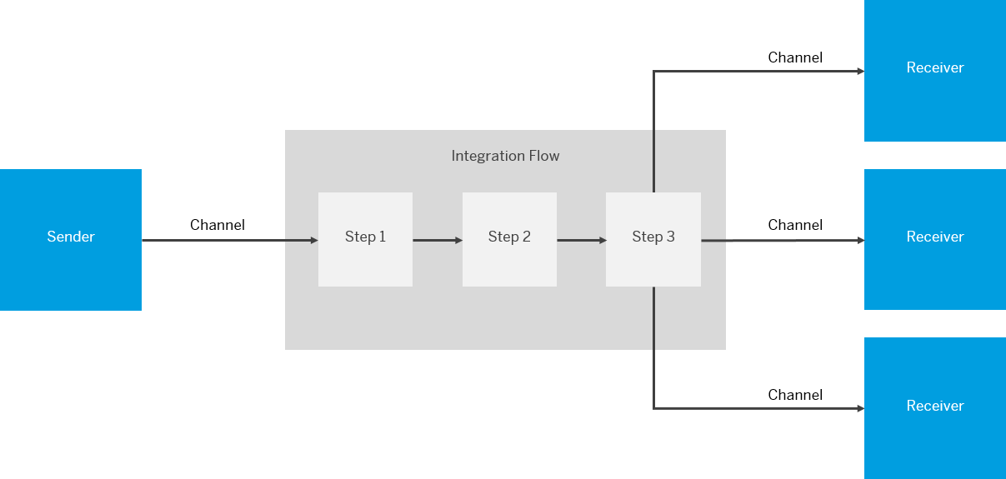
Integration Flows

Slide 50
Integration flow
An integration flow allows you to specify how a message is processed on a tenant.
The following figure provides a simplified and generalized representation of an integration flow.

Slide 51
Connecting a Customer System to Cloud Integration
You can set up the technical connection between a tenant and different kinds of remote systems (in many cases located in the customer landscape).
Inbound refers to message processing from a remote system (in many cases, located in the customer landscape) to Cloud Integration. Here, the integration platform is the server.
Outbound refers to message processing from the integration platform to a remote system (where the integration platform is the client).

Slide 52
Configuring Inbound Communication
Configuring inbound communication means setting up the connection between a remote sender system and the integration platform. Inbound communication refers to message processing from a remote system, often located in the customer landscape, to Cloud Integration. Here, the integration platform is the server

Slide 53
Sender Systems You Can Connect to the Integration Platform
You can connect different kinds of sender systems to the integration platform, for example:
A cloud application, for example, SAP SuccessFactors
An on-premise application, for example, SAP ERP
A SOAP client
An e-mail server
An SFTP server

Slide 54
Receiver Systems You Can Connect to the Integration Platform
A cloud application, for example, an SAP cloud application like SuccessFactors or SAP Cloud for Customer
An on-premise application, for example SAP ERP
You can connect on-premise systems (located in the customer system landscape) such as SAP systems. Typical use cases for this are hybrid integration scenarios, where an on-premise SAP application (for example, SAP ERP) is integrated with an SAP cloud application (for example, SAP Cloud for Customer or SAP SuccessFactors).
An e-mail server-In this case, the integration platform sends e-mails to the e-mail server (for an e-mail address specified in the related adapter).
An SFTP server-In this case, the integration platform writes files to the SFTP server.

Slide 55
Kind of Systems to Connect to Cloud Integration
To give you an idea of which kinds of remote systems can be connected to the integration platform, here are some typical examples (this is not a complete list):
On-premise systems, for example, SAP systems based on SAP NetWeaver
SFTP servers
Cloud applications, for example, SAP SuccessFactors or SAP Cloud for Customer
Other systems such as e-mail servers or SOAP clients

Slide 56
Overview of the SAP Cloud Integration Web UI
Discover
Design
Monitor

Slide 57
The SAP Cloud Integration Web UI is your one-stop shop for integration development.
Note that the URL to access the Web UI ends with /itspaces.
The Web UI comprises the following sections:
Discover
Here, you can find predefined integration content provided by SAP that you can use out of the box and adapt to your requirements. As the Getting Started documentation focuses on how to design your own integration content, we do not go into any more detail on this section.

Slide 58
Design
This is where you design your integration content. As you progress through the exercise in the Getting Started documentation, you will spend most of your time in this section. It contains the graphical integration flow modeling environment.
Monitor
This is where you can monitor your integration flow. You also use this section to manage additional artifacts that you need to deploy on your tenant to complement your integration flows (for example, User Credential artifacts to configure connections using basic authentication).

Slide 59
Design Section
Design Section
When you go to the Design section, you find a list of integration packages defined for the tenant.
When you select an integration package, you can find the integration flows (and other artifacts) defined for the package (on the Artifacts tab).
In this Getting Started documentation, we assume that you have not yet defined an integration package for your integration content. Therefore, the first step is to define an integration package.

Slide 60
Monitor Section
The Monitor section (also referred to as Operations view) has several subsections, each one containing several tiles. These subsections allow you to perform various tasks that are required for an integration project in addition to integration content design.

Slide 61
Monitor Message Processing
When you select a tile in this section, you find all messages that have been processed by all integration flows deployed on the tenant. You can find out whether messages have been processed successfully for your integration flow and analyze the situation if not.
Manage Integration Content
When you select a tile in this section, you find all deployed integration flows and can check whether deployment was successful. You can also find the endpoint address for your integration flow (which you need if you want to configure the endpoint in the connected sender system).

Slide 62
Manage Security
The Security Material tile contains security-related artifacts that are required on the tenant in addition to the security-relevant settings in your integration flow. In the course of the following exercise, you will create and deploy a User Credentials artifact to define the user name and password for the mail account that is addressed by the Mail receiver adapter of the integration flow.
The Keystore tile shows the content of the tenant keystore, which contains key pairs and certificates required to set up connections that are protected using certificate-based authentication. In the exercise, we need to add certificates when setting up the connection to the e-mail receiver.
The Connectivity Tests (only available in the Neo environment) tile allows you to test outbound connections (from SAP Cloud Integration to a receiver system). We use the connectivity test tool to retrieve the certificates of the e-mail receiver that need to be imported into the tenant keystore.

Slide 63
Integration Capabilities
Feature | Description
Mapping | Transforms the data structure and format used by the sender into a structure and format that the receiver can process. Supports the following kinds of mappings: Message mappings designed with a graphical editor as part of the Cloud Integration toolset (supports XSD and EDMX structures) Custom-mapping functions defined in scripts XSLT mappings (defined in an XSLT resource)
ID Mapping | Maps the source message ID to a target message ID. You can use this feature to implement scenarios with exactly once processing of messages.
Content Modifier | Modifies the content of an inbound message by changing the header or body of the message. A message is composed of a message body and message headers. Furthermore, when being processed on a Cloud Integration tenant, additional data associated with the message can be passed along in an additional container (referred to as message exchange) to make it available at a later point in time during message processing. The Content Modifier can read data from and write data to the message body, the message header, and the properties area of the message exchange. That way, the content of a message can flexibly be modified and prepared for a receiver or subsequent processing steps. Certain constraints apply with regard to the supported data formats (as described in the product documentation).
Message transformation

Slide 64
XML Modifier | Modifies the content of an inbound message by removing external DTDs and/or removing XML declarations.
Converter | Transforms an input message into another format. The following converters are available: XML to JSON: Transforms messages in XML format to JSON format. You can specify streaming (with either the whole XML document or only specified XML elements presented by JSON arrays). JSON to XML: Transforms messages in JSON format to XML format. XML to CSV: Transforms messages in XML format to CSV format. CSV to XML: Transforms messages in CSV format to XML format. XML to EDI: Transforms a message in XML format to Electronic Data Interchange (EDI) format. EDI to XML: Transforms a message in EDI format (EDIFACT or ASC-X12 format) to XML format. Certain constraints apply with regard to the supported data formats (as described in the product documentation).

Slide 65
Decoder | Decodes the incoming message to retrieve the original data (for example, if a base64-encoded message has been received). Base64 Decode: Decodes base64-encoded message content. GZIP Decompress: Decompresses the message content using GNU zip (GZIP). ZIP Decompress: Decompresses the message content using zip (only zip archives with a single entry supported). MIME Multipart Decode: Transforms a MIME multipart message into a message with attachments.

Slide 66
Converter | Transforms an input message into another format. The following converters are available: XML to JSON: Transforms messages in XML format to JSON format. You can specify streaming (with either the whole XML document or only specified XML elements presented by JSON arrays). JSON to XML: Transforms messages in JSON format to XML format. XML to CSV: Transforms messages in XML format to CSV format. CSV to XML: Transforms messages in CSV format to XML format. XML to EDI: Transforms a message in XML format to Electronic Data Interchange (EDI) format. EDI to XML: Transforms a message in EDI format (EDIFACT or ASC-X12 format) to XML format. Certain constraints apply with regard to the supported data formats (as described in the product documentation).
Decoder | Decodes the incoming message to retrieve the original data (for example, if a base64-encoded message has been received). Base64 Decode: Decodes base64-encoded message content. GZIP Decompress: Decompresses the message content using GNU zip (GZIP). ZIP Decompress: Decompresses the message content using zip (only zip archives with a single entry supported). MIME Multipart Decode: Transforms a MIME multipart message into a message with attachments.
Converter | Transforms an input message into another format. The following converters are available: XML to JSON: Transforms messages in XML format to JSON format. You can specify streaming (with either the whole XML document or only specified XML elements presented by JSON arrays). JSON to XML: Transforms messages in JSON format to XML format. XML to CSV: Transforms messages in XML format to CSV format. CSV to XML: Transforms messages in CSV format to XML format. XML to EDI: Transforms a message in XML format to Electronic Data Interchange (EDI) format. EDI to XML: Transforms a message in EDI format (EDIFACT or ASC-X12 format) to XML format. Certain constraints apply with regard to the supported data formats (as described in the product documentation).

Slide 67
Decoder | Decodes the incoming message to retrieve the original data (for example, if a base64-encoded message has been received). Base64 Decode: Decodes base64-encoded message content. GZIP Decompress: Decompresses the message content using GNU zip (GZIP). ZIP Decompress: Decompresses the message content using zip (only zip archives with a single entry supported). MIME Multipart Decode: Transforms a MIME multipart message into a message with attachments.

Slide 68
Encoder | Encodes the message using an encoding scheme to secure any sensitive message content during transfer over the network. Base64 Encode Encodes the message content using base64. GZIP Compress: Compresses the message content using GNU zip (GZIP). ZIP Compress: Compresses the message content using zip (only zip archives with a single entry supported). MIME Multipart Encode: Transforms the message content into a MIME multipart message. If you want to send a message with attachments, but the protocol (for example, HTTP or SFTP) does not support attachments, you can send the message as a MIME multipart instead. Note Note that SAP Cloud Integration does not support the processing of MIME multipart messages that contain multiple attachments with the same file name.

Slide 69
Filter | Filters information by extracting a specific node from the incoming message by using an XPath expression.
Message Digest | Calculates a digest of the payload or parts of it and stores the result in a message header.
Script | Executes custom Java script or Groovy script for message processing.

Slide 70
Calling External Systems or Subprocesses
Feature | Description
Request-Reply | Calls an external receiver system in a synchronous step and gets back a response.
Send | Calls an external receiver system for use cases where no reply is expected.
Content Enricher | Calls an external system, accesses resources of this system, and merges the returned content with the original message.
Poll Enrich Step | Polls content from an external component, and enriches the original message with it.
Process Call | Calls a local integration process. A local integration process defines a container for a separate subprocess to be called from the main process. Using local integration processes, a complex message processing sequence can be fragmented and decomposed into smaller parts.
Looping Process Call | Calls a local integration process in a loop.
Idempotent Process Call | Detects if a message ID has already been successfully processed and stores the status of the successful process in the idempotent repository. If there's duplicate execution with the same message ID (for example if there’s a retry by the sender system), the called subprocess can either be skipped or the message is marked as a duplicate. You can then decide how to handle the duplicate in the subprocess.

Slide 71
Routing
Description
Routes a message to one or more receivers. SAP Cloud Integration also supports routing that depends on the content of the message (content-based routing). For example, the tenant detects that a message has a particular field value, and forwards it to the specific receiver participant that handles requests from the sender participant.
Sends the same message to more than one receiver. Parallel multicast: Initiates message transfer to all the receiver nodes in parallel Sequential multicast: defines the sequence in which the message transfer to the receivers is initiated.
Decomposes a composite message into a series of individual messages and sends them to a receiver. Supported splitters: General splitter: Breaks down a composite message containing ‘n’ messages into ‘n’ individual messages. Each individual message is enveloped by the same elements that enveloped the composite message. Iterating splitter: Splits a composite message into a series of smaller messages without copying the enveloping elements of the composite message PKCS#7/CMS splitter: Splits a PKCS7 Signed Data message that contains a signature and content (and breaks down the signature and content into separate files) IDoc splitter: Splits a composite IDoc messages into a series of individual IDoc messages with the enveloping elements of the composite IDoc message EDI splitter: Splits a bulk EDI message into a series of individual messages and validates and acknowledges the inbound message. A bulk EDI message can contain one or more EDI formats, such as EDIFACT, EANCOM, or ASC-X12. The EDI splitter can process different EDI formats depending on the business requirements of the trading partners. Zip splitter: Splits an inbound archive file (.zip) into individual files. Certain constraints apply with regard to the supported data formats (as described in the product documentation).

Slide 72
Join | Merges messages from different routes and combines them into a single message. This feature is used in combination with the Gather feature. Join simply brings together the messages from different routes; it doesn't affect the content of the messages. Certain constraints apply with regard to the usage of this feature (as described in the product documentation).
Gather | Merges messages from different routes (into a single message) with the option to define certain strategies how to combine the initial messages.

Slide 73
Storing Data During Processing
Feature | Description
Persist Message | Stores a message payload so that you can access the stored message and analyze it at a later point in time.
Data Store Operations | Stores messages temporarily for later processing. The following operations are supported: SELECT GET WRITE DELETE
Write Variables | Specifies values for variables required during message processing.

Slide 74
Protecting Messages
Description
Encrypts the content of a message. Supported standards: PGP PKCS#7/CMS Enveloped Data and Signed Data
Decrypts the content of a message. Supported standards: PGP PKCS#7/CMS Enveloped Data and Signed Data
Signs a message. Supported standards: PKCS#7/CMS Enveloped Data and Signed Data XML Digital Signature

Slide 75
Verifier | Verifies a message. Supported standards: PKCS#7/CMS Enveloped Data and Signed Data XML Digital Signature

Slide 76
QnA/Recap
How many component are in CPI
What are option available in Monitoring component
What is adapters
How many components are in SAP IS

Slide 77
Thank you

